Slide 1
+
Institute of Software Technology
Predicting and Learning the Performance of Configurable Systems
Seminar Advanced Software Engineering

Slide 2
Agenda

Slide 3
Motivation and Problem

Slide 4
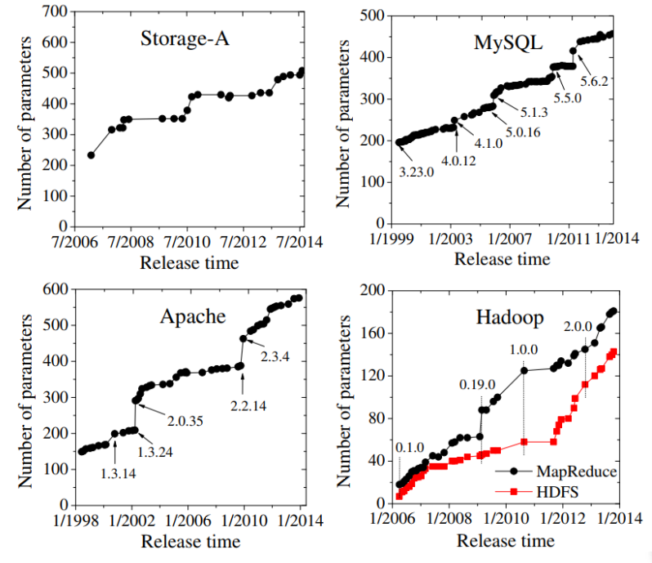

Motivation: Configurations matter!
Programs are getting more and more configuration options.

Slide 5
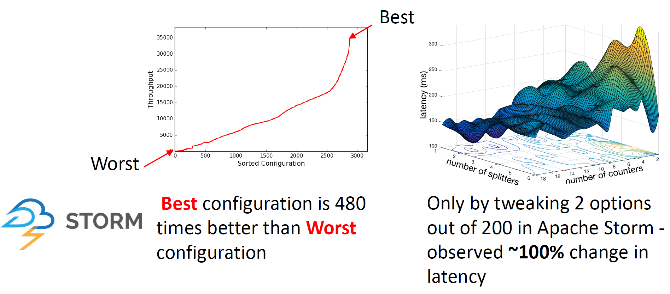
Motivation: Configurations matter!
But: Bad configurations can have a big impact on performance:
More Configurations
More Possibilities of Performance Influences
Performance prediction is hard.

Slide 6

Motivation: Configurations matter!
Other reasons:
Finding optimized configurations
Finding good default configurations
Find problems in the implementation
Proof a good average performance
Can’t we just measure every configuration?

Slide 7

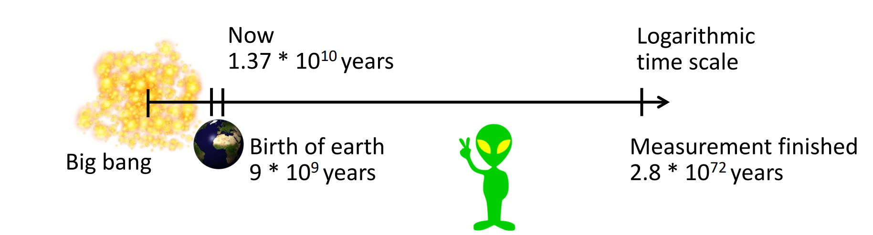
The Problem: Examples
Have a look at Berkley DB (C):
19 features
2560 configurations
426h (~18d) for brute force testing
Let’s go larger!
with SQLite!
77 features
3∙10⁷⁷ configurations
Assumption: 1 measurement = 5min (compilation + benchmark)
Notes:
Berkley DB ~ 10min per config

Slide 8
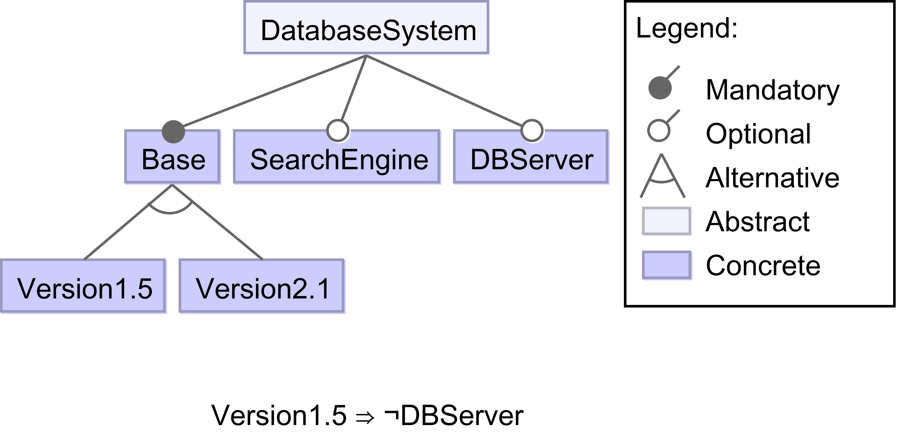
The Problem: Exponential Configuration Space
Looking at…
all configurations
or
a single configuration
Configuration
N-
dimensional Vector
Logical Expression
(500, 0.5, 1)
a ∧ ¬b ∧ c
⇔
Examples (N=3)
Valid = Base ∧ (Version1.5 ⊕ Version2.1)
∧ (Version1.5 ⇒ ¬DBServer)
⇒ all possible configurations (Configuration Space) ∈ O(2^{#options})

Slide 9
Performance Learning and Prediction

Slide 10
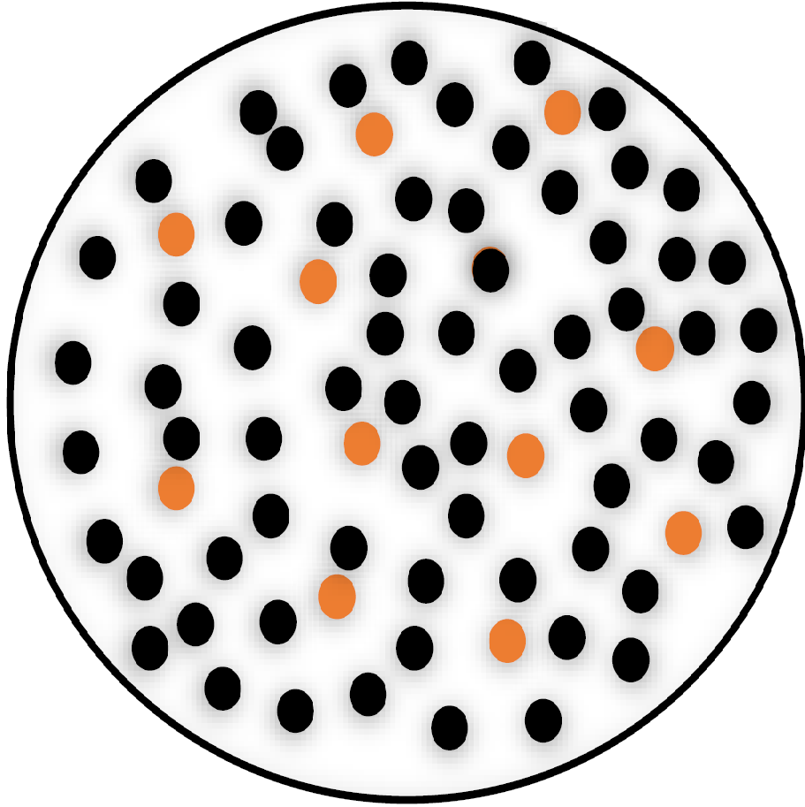
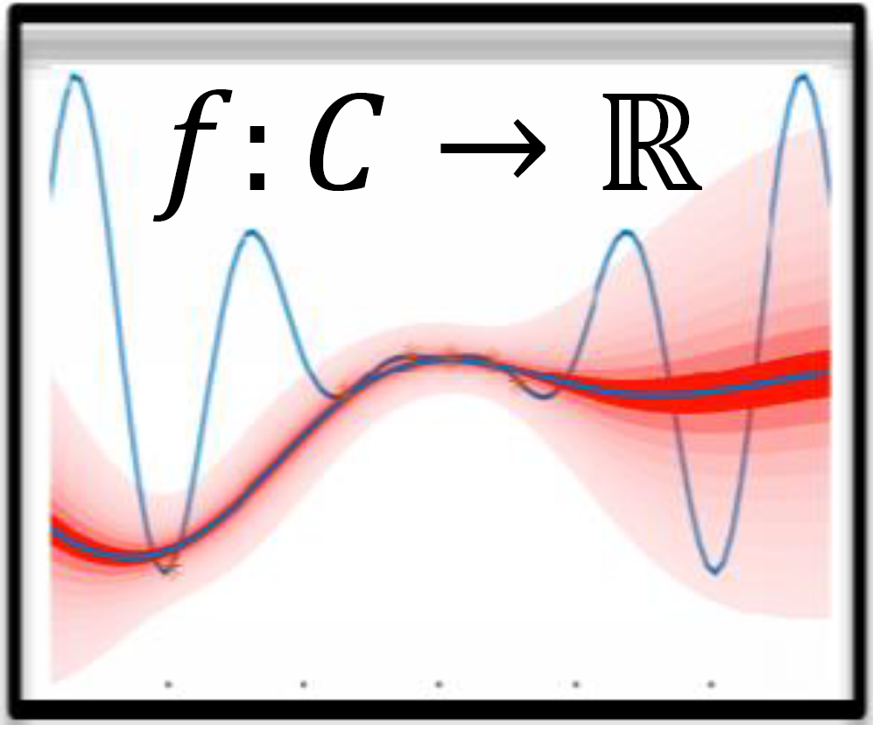
The General Approach
Sampling
Learning
Prediction
Optimization
Analysis
Improving Samples
Prediction Approach = Sampling Method + Learning Method
Presented Approaches
Brute Force
Automated Features Interaction Detection
Classification and Regression Tree based Approaches

Slide 11
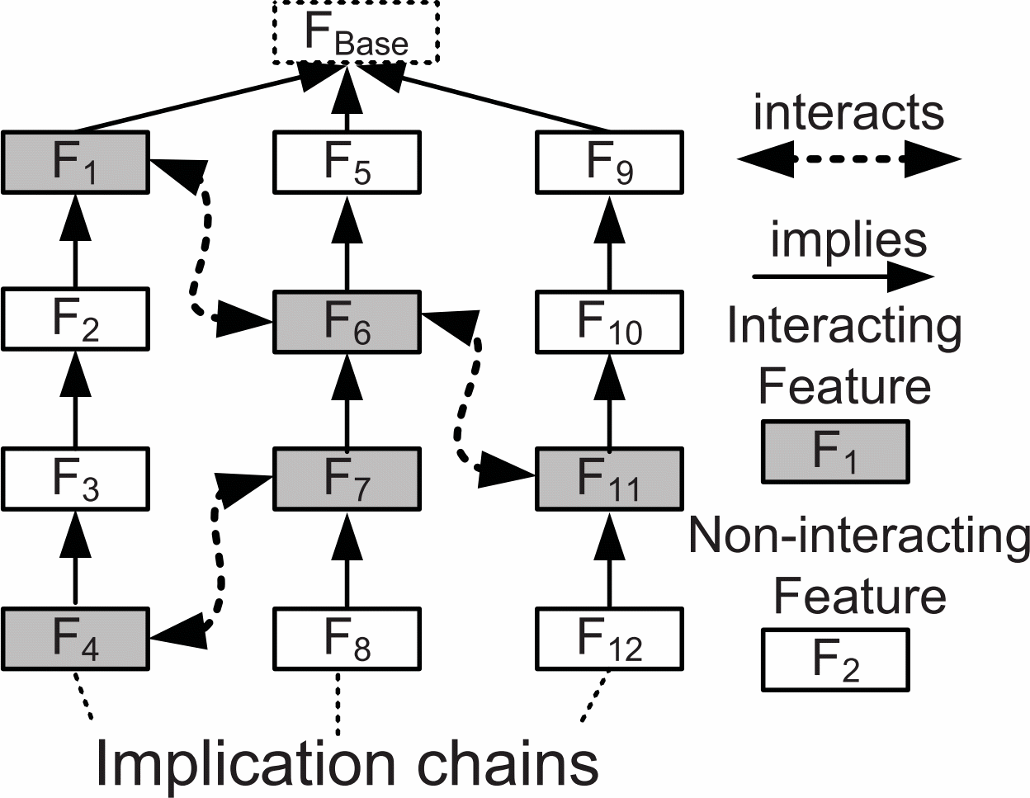
Automated Feature Interaction Detection
Goal: assign a performance influence value ∏ to each feature
Step 1: Find interacting features
for each feature a do…
∏(a)=∏(min(a)×a)-∏(min(a))
compute
∏(min(a)×a)
∏(max(a)×a)
yes
equal?
no
Mark a as interactive
Step 2: Measure feature interaction impact
Pair-Wise Heuristic
Measure Performance Impact
Higher-Order Heuristic
Isn’t this still exponential?
Hot-Spot Heuristic
O(n²) Pairs
Yes!

Slide 12

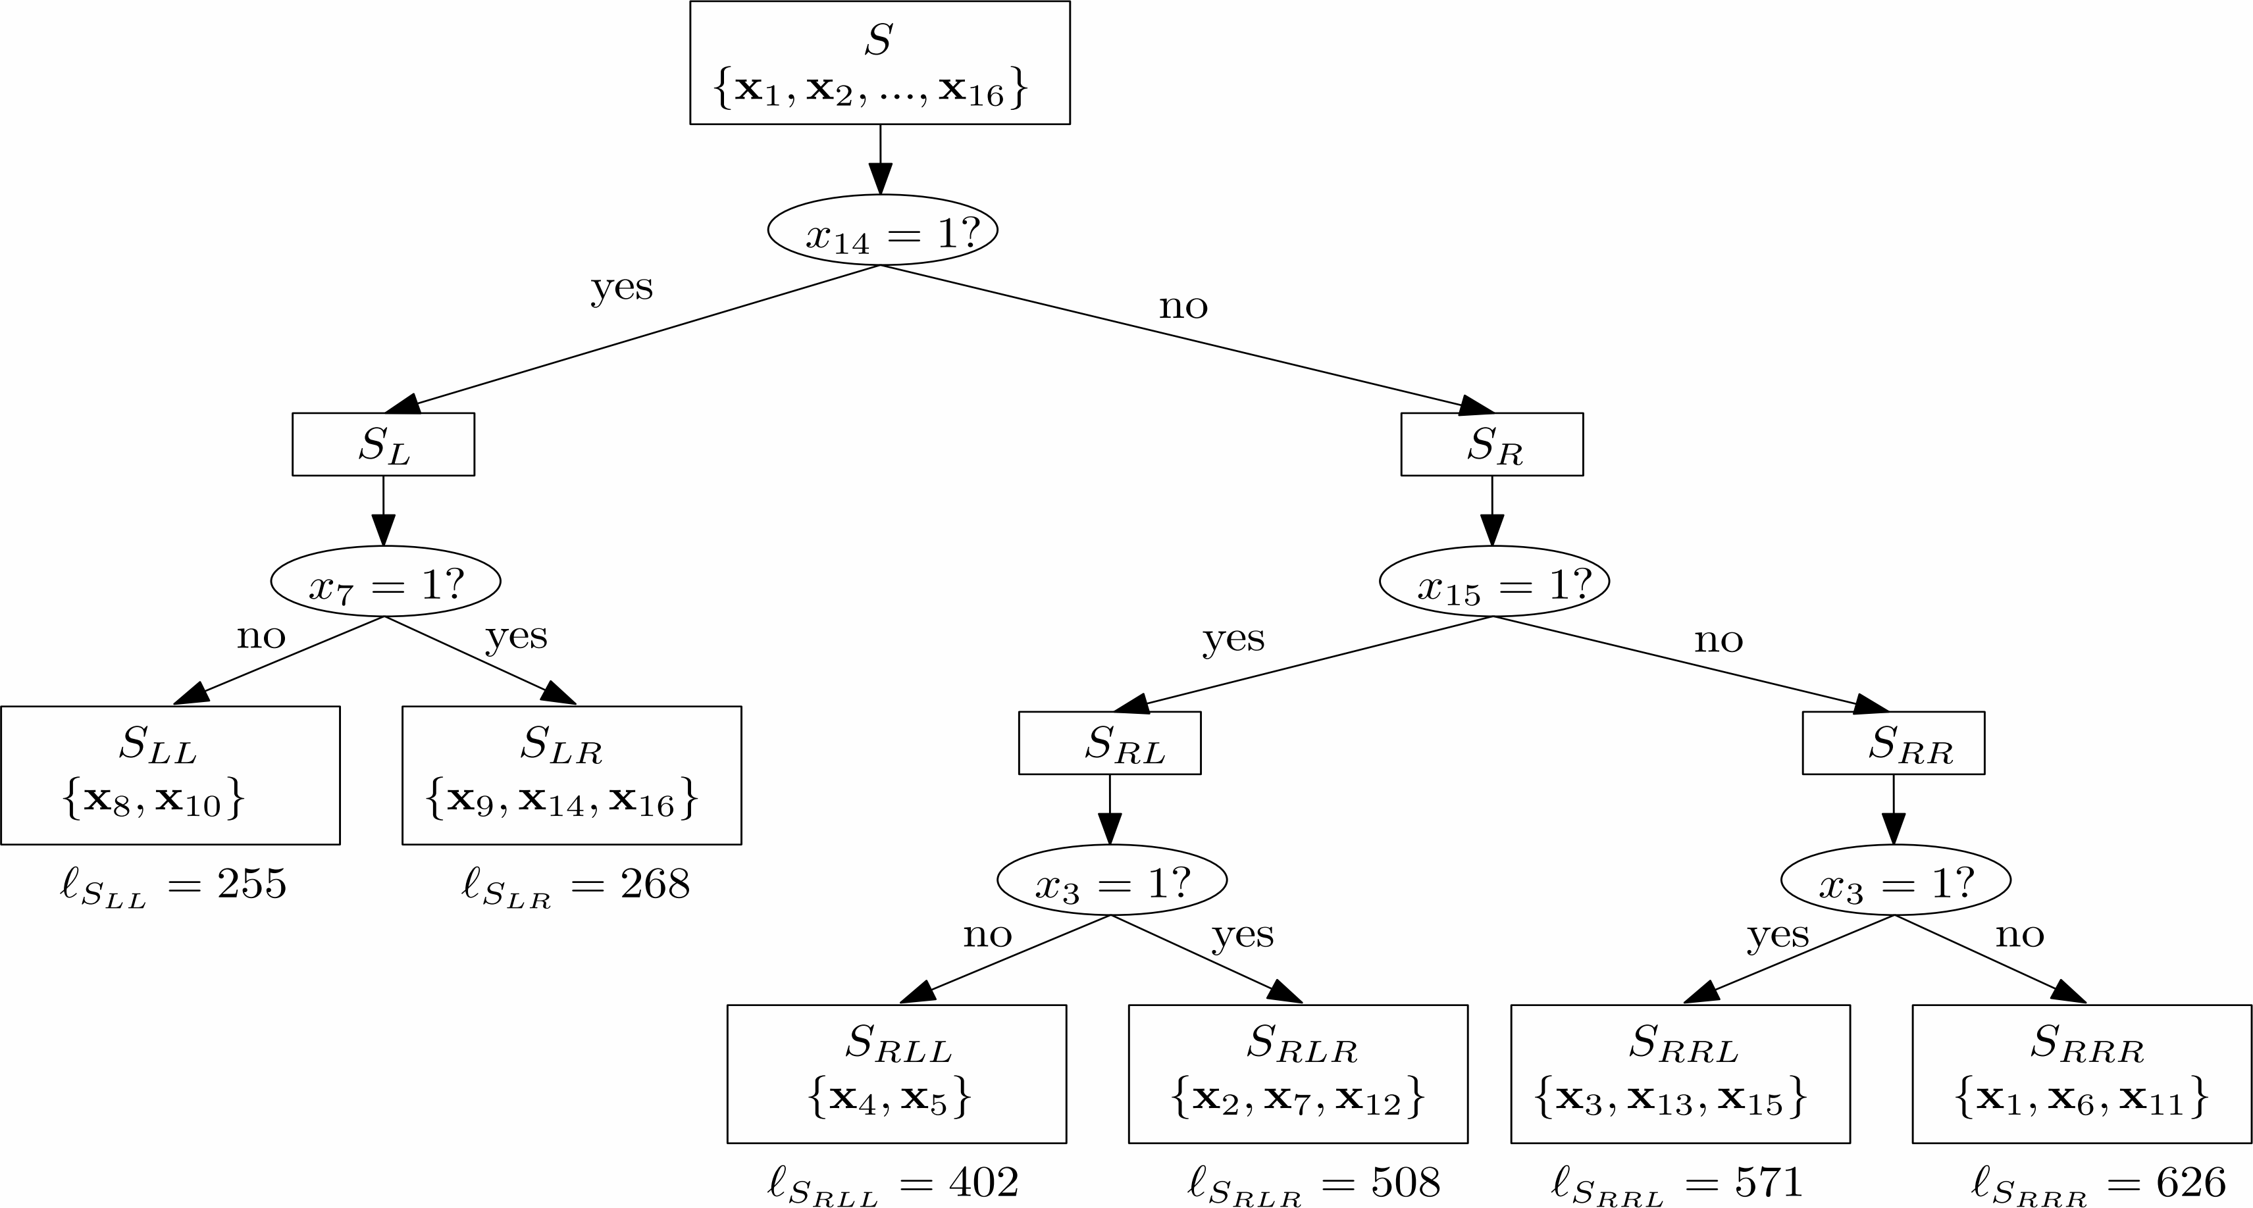
Classification and Regression Trees (CART)
Set of data points D + Evaluation Function + balancing Heuristic
Used to classify data points in statistics
CART heuristic mostly based on minimal squared error loss of a performance value (in our case)

Slide 13
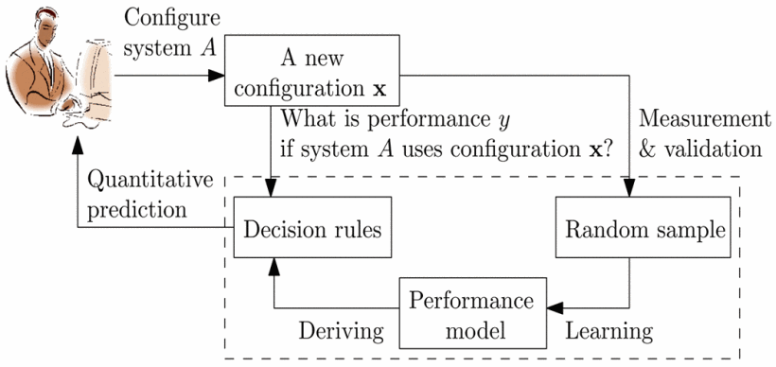
Variability Aware Performance Prediction
Statistical Approach
Sample size can be chosen freely
Chose a
random sample
Measure all
chosen configurations
Generate CART
Derive Prediction Rules
random
all

Slide 14
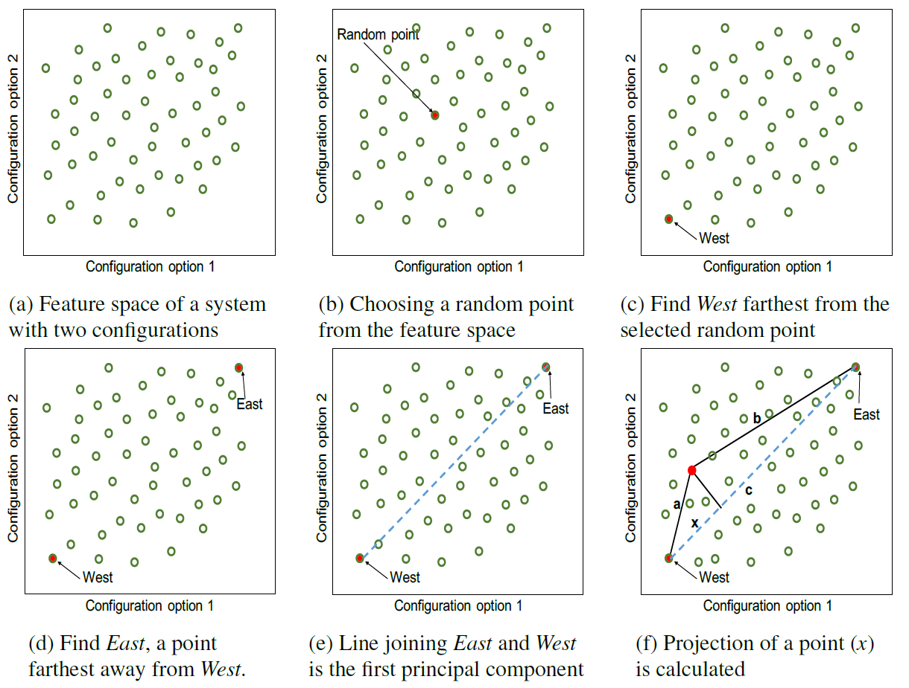
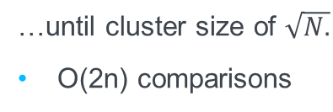
WHAT
Uses Spectral Learning like clustering method…
Clustering by distance vector between configurations.
Chose a random configuration from each leaf cluster and measure it.
Build a CART
…until cluster size of $\sqrt{N.}$
O(2n) comparisons
Other cluster algorithms are possible
Most cluster algorithms use more comparisons

Slide 15
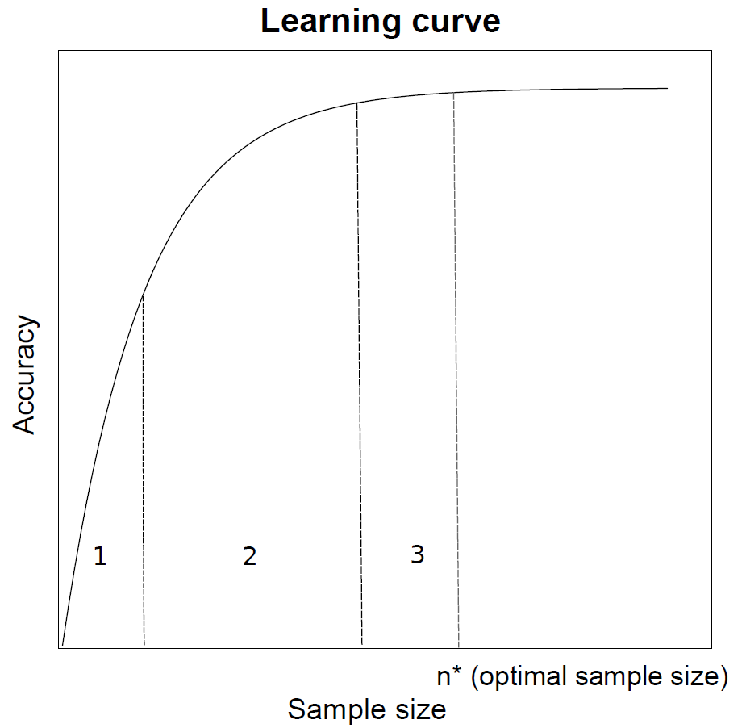
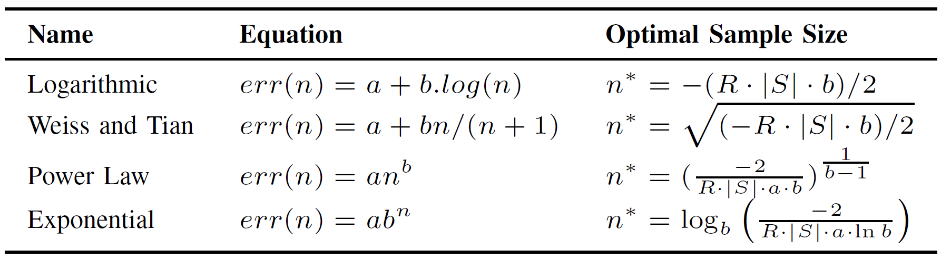


Cost Efficient Sampling
Tires to find an optimal sample size with curve fitting
Iterative/randomized process
Function fitting
Substitute $err(n)$ with function and find minimum $$=n^{∗}$$
accuracy thresholds reached
Start
Add (1 or more) random configuration(s)
Build a performance model (CART)
Evaluate
mean errors
Add point to learning curve
$$TotalCost\left(n\right)=2n+err(n)∙\left|S\right|∙R$$
Build CART
with an optimal
sized sample

Slide 16
Overview Approaches
AFID:
Find interacting features by measuring
Determine influence of Interactions
Chose random sample
Measure all chosen configurations
Build a CART
VAPP:
Cluster configurations
Measure one configuration of each leaf cluster
Build a CART
Derive Prediction Rules
WHAT:
More Effective Sampling:
Projective Sampling

Slide 17
Short comparison of advantages and disadvantages

Slide 18
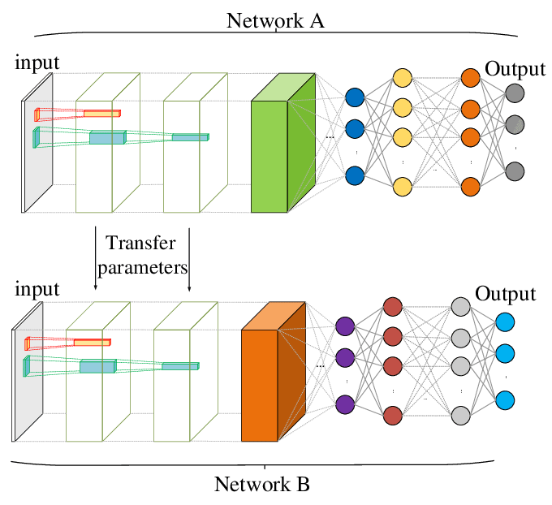
Shoutouts
Fourier Learning
Transfer Learning
transfer knowledge between two learning systems

Slide 19
Final/Concluding Slide

Slide 20
Institute of Software Technology
Lion Wagner
st148345@stud.uni-stuttgart.de
Institute of Software Technology

